Slide 2
Feature Representation
Feed-back, generative, top-down
Decoder
Encoder
Feed-forward, bottom-up
Input Vector

Slide 3
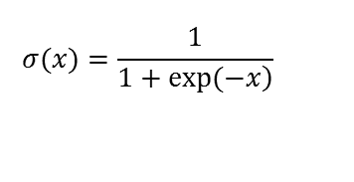

Binary Features z
Decoder filters D
D z
Encoder filters W
z=$σ$(Wx)
Linear function
Sigmoid function
$$σ(x)=\frac{1}{\left.1+exp(−x\right)}$$
Input Vector x

Slide 4
Feature Representation
Feed-back, generative, top-down
Decoder
Encoder
Input Vector
Stochastic
Corruption
Corrupted Input Vector

